Slide 1
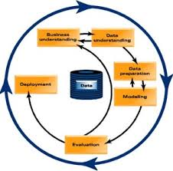

CRISP-DM

Slide 2
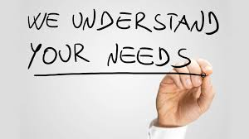
Business Understanding
Assess the situation
Determine business objectives
Determine the predictive modeling goals
Identify the criteria to assess success
Produce the project plan
Notes:
This initial phase focuses on understanding the project objectives and requirements from a business perspective, and then converting this knowledge into a data mining problem definition, and a preliminary plan designed to achieve the objectives. This is and following descriptions are taken from Wikipedia.

Slide 3

Under the Hood: Business Understanding
Lack of business understanding is the most common cause of project failure
The business objectives may only be broadly stated
The goals and success criteria depend heavily on the application
The project plan is not only useful for obtaining resources but also managing expectations
Notes:
Once you begin a data mining project, you quickly get beyond the high-level, normative description of what to do, and into the practical realities. These practical considerations are analogous to getting under the hood of a car to see what is going on.

Slide 4

Data Understanding
Collect the initial data
Profile the data
Verify data quality
Notes:
The data understanding phase starts with an initial data collection and proceeds with activities in order to get familiar with the data, to identify data quality problems, to discover first insights into the data, or to detect interesting subsets to form hypotheses for hidden information.

Slide 5
Under the Hood: Data Understanding
Access to data is not always guaranteed – that is why you need a strong project sponsor
Carefully select your data source(s) – transactional systems, data warehouse, data lake, or third party
Automated data profiling is important – allows you to assess the quality of the data
Knowing the distributions of the data provides insights as to what models can be used
Notes:
Once you begin a data mining project, you quickly get beyond the high-level, normative description of what to do, and into the practical realities. These practical considerations are analogous to getting under the hood of a car to see what is going on.

Slide 6



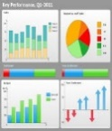

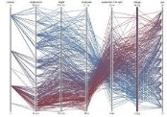

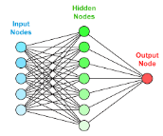
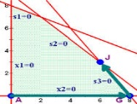

Data
Models/
Applications
Users
Data Sources
Cloud/On-Premises
Data Stores
IoT/
Streaming
SQL Queries
Casual Users
Streaming/
CEP Engines
Power Users
Operational
Systems
Dashboards
Visualization
Citizen
Data Scientists
ERP
Data
Warehouse
Dependent
Data
Marts
Data Lake
Business/BI Analysts
Web/Internet
Power Analysts
Audio/Video
Hadoop
Cluster
Analytical
Sandboxes
AI
Engines
Data Scientists
Social
Media
Application
Developers
Documents
And Text
Non-SQL
Databases
Customers
APIs
Suppliers
Notes:
The reference architecture in the slide provides a good starting point for thinking about a possible architecture to support the needs of today’s organizations preparing for advanced decision support. This architecture supports the full range of BI/analytics, including those that employ AI. It includes many kinds of data, data storage devices, BI/analytics and users. It also includes components that became important with the emergence of big data—Hadoop, data lakes, streaming/critical event processing (CEP) engines, analytical sandboxes and non-SQL databases. Some of the components— AI engines, APIs for AI-based services and citizen data scientists.
The architecture includes hybrid data storage with both cloud and on-premises components. Especially for smaller and mid-sized organizations, AI and other BI/analytics capabilities will be accessed through the cloud as analytics-as-a-service.
The reference architecture includes a Hadoop-based data lake. Because of the decreased cost of storage and processing with Hadoop and the ability to store data in a native format (i.e., without a predefined data model), many organizations are storing large amounts of raw data in a data lake. The rationale is that when raw data is needed for BI/analytics, it is available in the lake.
Some have posited that Hadoop clusters will replace data warehouses because of their lower cost, but this currently seems unlikely. Organizations have invested heavily in their data warehouses to provide a “squeaky clean” repository of decision-support data. These warehouses provide an important analytics production capability for reporting, dashboards/scorecards and financial and compliance reporting. In the cognitive generation, however, there will be more data storage platforms (e.g., non- SQL databases) that store different kinds of data (e.g., IoT data streams) and support various kinds of specialized BI/analytics (e.g., sentiment analysis), but there will continue to be an important production role for data warehouses. Shawn Rogers, one of the interviewed experts, uses the metaphor that the warehouse was previously the center of the decision-support universe but is now just one of many planets as new, specialized platforms have emerged.
There are many options for processing streaming data from IoT devices. The Apache Software Foundation, which provides Hadoop, also offers a variety of open-source projects (i.e., products) that can be used to provide streaming data solutions. Major vendors such as Amazon, Microsoft and IBM also have streaming data offerings. There are also specialized products for specific types of applications (e.g., homes, cars).
Another component of the reference architecture is analytical sandboxes. Many organizations have created analytical sandboxes that analysts and data scientists use to build and test their models for advanced BI/analytics. In a real (i.e., physical) sandbox, data from the warehouse and other sources is loaded into a separate platform, such as an appliance. In a virtual sandbox, a partition of the data warehouse is loaded with the data the modelers need. Thus the data warehouse and sandbox reside in the same database software but operate as separate systems.
There are two main reasons for creating a sandbox. The first is to take the processing load, which can be very heavy for advanced BI/analytics applications, off of the warehouse. This avoids potential performance problems with descriptive analytics, such as reports and dashboards. The second reason is to allow analysts and data scientists more control over the data they need. For example, they can load new data sets without going through potentially long warehouse approval processes.
The bottom of the figure shows developers building production-grade applications, which potentially may use any of the data sources, data stores and BI/analytics tools. For example, the machine learning APIs from sources such as Microsoft and Amazon can be used to build AI-based applications. There will also be on-premises AI engines.
The reference architecture shown in the figure has many components that must be integrated. The following guidelines can be used to achieve the required integration:
(1) Applications should be able to quickly and seamlessly access data from any storage platform. For example, a dashboard should be able to access and integrate data from a data mart and a non-SQL database.
(2) Each platform should be used for the work that it is best suited to. For example, Hadoop is appropriate for taking large amounts of data, filtering it and making the results available, possibly to a BI/analytics application or a data warehouse.
(3) Each platform should be used in a way that best matches its value-creation capabilities. For example, a data warehouse is best for reporting what has happened in the past and what is happening now, and for providing guidance on how to adapt going forward.
(4) The platforms should share data and analytics results in “right time.” For example, an analysis may be running on one platform and need data or a BI/analytics result from a different platform. Vendors are making progress in integrating their platforms and those of other vendors.

Slide 7

Data Preparation
“Predictive modeling performance is only as good as your data, and your data is only as good as the way you prepare it for modeling.”
Select data
Clean data
Construct data
Integrate data
Format data
Notes:
The data preparation phase covers all activities to construct the final dataset (data that will be fed into the modeling tool(s)) from the initial raw data. Data preparation tasks are likely to be performed multiple times, and not in any prescribed order. Tasks include table, record, and attribute selection as well as transformation and cleaning of data for modeling tools.

Slide 8
Under the Hood: Data Preparation
A required, time-consuming part of any analytics project
Also called “data wrangling”
Data is pulled into a single table
A common primary key is needed to integrate the data
Data is needed for training (i.e., model building) and testing – data splitting is commonly done
All data must be categorized correctly
Notes:
Once you begin a data mining project, you quickly get beyond the high-level, normative description of what to do, and into the practical realities. These practical considerations are analogous to getting under the hood of a car to see what is going on.

Slide 9
Under the Hood: Data Preparation
Decisions need to be made about how to handle anomalies (normally an incorrect value), outliers (typically 3 sigma), and missing values
Means, medians, or predicted values may be used with missing values (add a column if a missing value is estimated). Or delete the record
Logarithmic transformations and binning are common with outliers and skewness
Features – new versions of one or more attributes – may be required; work with a domain expert (add a new column in the data)
Notes:
Once you begin a data mining project, you quickly get beyond the high-level, normative description of what to do, and into the practical realities. These practical considerations are analogous to getting under the hood of a car to see what is going on.

Slide 10
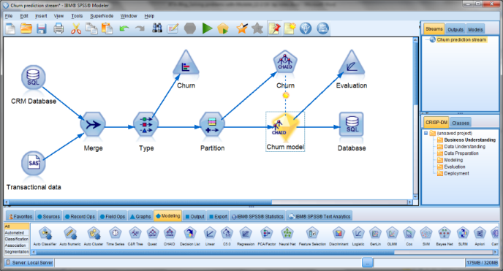
Modeling
Select the modeling technique
Generate test design
Build the model
Assess the model
Notes:
In this phase, various modeling techniques are selected and applied, and their parameters are calibrated to optimal values. Typically, there are several techniques for the same data mining problem type. Some techniques have specific requirements on the form of data. Therefore, stepping back to the data preparation phase is often needed.

Slide 11
Under the Hood: Modeling
There are models for categorical and continuous dependent variables
There is supervised (dependent variable specified) and unsupervised (categories determined by the algorithm) learning
Be careful of overfitting the model – too many variables for the amount of the data
Be careful of correlated independent variables
Notes:
Once you begin a data mining project, you quickly get beyond the high-level, normative description of what to do, and into the practical realities. These practical considerations are analogous to getting under the hood of a car to see what is going on.

Slide 12
Under the Hood: Modeling
Be careful of spurious correlations
Multiple, competing models are built
An ensemble of models may be used – either they are combined or used for ranges of the dependent variable
The models are evaluated on the basis of statistical and other criteria
Notes:
Cheese consumption is correlated with the number of people who died by becoming tangled in their bedsheets. Spurious correlations is normally the result of small sample sizes or a third variable that causes the other two variables to be correlated.
Sometimes predictions are based on an ensemble of models rather than a single one. With this approach, multiple models are combined in order to develop better predictions than are possible with a single model. For example, when predicting income, one model may be best for low to medium incomes while another is best for higher income individuals.

Slide 13

Evaluation
Review process
Evaluate results
Determine next steps
Notes:
At this stage in the project you have built a model (or models) that appears to have high quality, from a data analysis perspective. Before proceeding to final deployment of the model, it is important to more thoroughly evaluate the model, and review the steps executed to construct the model, to be certain it properly achieves the business objectives. A key objective is to determine if there is some important business issue that has not been sufficiently considered. At the end of this phase, a decision on the use of the data mining results should be reached.
“A good model is one that is better than what is currently being done!”

Slide 14
Under the Hood: Evaluation
Can the model accurately predict instances that it has not seen before?
Data is split into training and testing data sets
Data is sometimes held out for final validation
Models with categorical dependent variables are commonly assessed on accuracy percentage and/or confusion matrix
Notes:
Once you begin a data mining project, you quickly get beyond the high-level, normative description of what to do, and into the practical realities. These practical considerations are analogous to getting under the hood of a car to see what is going on.

Slide 15
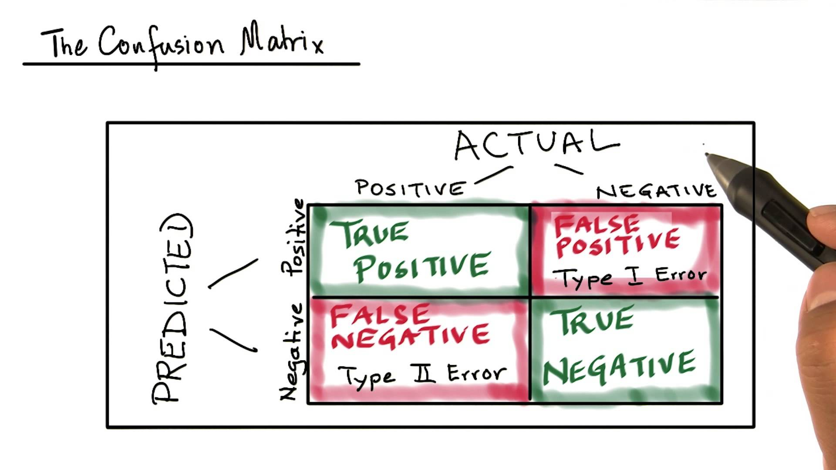
Accuracy=(TP+TN)/(TP+FP+FN+TN)
Precision=TP/(TP+FP)
Recall=TP/(TP+FN)
Learn more about accuracy, precision, and recall here

Slide 16
Using the Confusion Matrix
With a perfect model, all test cases align along the principal diagonal – but this is never the case
Models identify the cutoff probability that maximizes the placement accuracy
But some errors are worse than others, and require a business decision about the cutoff probability
Let’s consider predicting credit card fraud

Slide 17
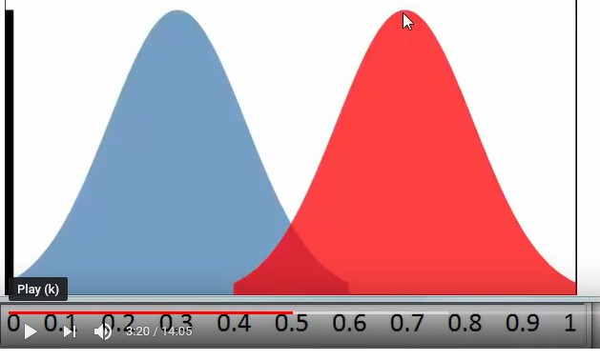
Predictions of Credit Card Fraud
No Fraud
Fraud
Cutoff Probability
Probability Density
Probability
Notes:
Our model detects credit card fraud. For every credit card transaction, the model calculates the probability that the transaction is fraudulent. In some cases the probability is so high or low that it is clear whether the transaction is fraudulent or not.
In the figure above, the red curve shows fraudulent transactions as a function of the model’s probability of fraud. If the probability is 0.6 or higher, the transaction is always fraudulent. But it can also be fraudulent with a probability as low as 0.4. The blue curve is for non fraudulent transactions. Interestingly, a transaction can have a fraudulent probability prediction as high as 0.6 and still be non fraudulent. The question is where to set the cutoff probability for deciding whether a transaction is fraudulent or not. Probabilities of fraud between 0.4 and 0.6 are associated with both non fraudulent and fraudulent transactions.
Like most software, BigML sets the cutoff probability in such a way as to maximize the predictive accuracy of the model. In many cases this is fine, but it makes the implicit assumption that Type I and Type II errors are equally costly. In our credit card example, a Type I error is predicting a transaction is fraudulent when it is not (i.e., a false positive). A Type II error is predicting a transaction is non fraudulent when it really is. In the case of Type I errors, we are likely to call the credit card holder, ask about the transaction, and learn that is okay. With the Type II error, we approve a fraudulent transaction. Each of these errors involve costs, which we can estimate. Probably the cost of a Type II error (approving a fraudulent transaction) is greater than a Type I error. The best cutoff probability to use in our application is the one that minimizes the sum of the costs of Type I and Type II errors. Depending on the cost of Type I and II errors, the best cutoff probability may be one that does not result in the highest model predictive accuracy, but rather, one that minimizes the total sum of the costs of Type I and II errors.

Slide 18
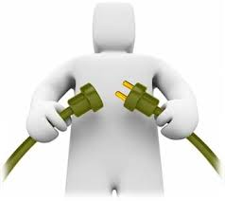
Deployment
Plan deployment
Plan monitoring and maintenance
Produce final report
Review project
Notes:
Creation of the model is generally not the end of the project. Even if the purpose of the model is to increase knowledge of the data, the knowledge gained will need to be organized and presented in a way that is useful to the customer. Depending on the requirements, the deployment phase can be as simple as generating a report or as complex as implementing a repeatable data scoring (e.g. segment allocation) or data mining process. In many cases it will be the customer, not the data analyst, who will carry out the deployment steps. Even if the analyst deploys the model it is important for the customer to understand up front the actions which will need to be carried out in order to actually make use of the created models.

Slide 19
Under the Hood: Deployment
Models need to be integrated into operational systems
Models become out-of-date (i.e., model drift) as conditions change in the environment or with the product or service or source systems
Updating hundreds or thousands of models is challenging
Model management needs to be automated
As analytics moves from a “cottage industry” to a “factory environment” there is a need for MLOps
Notes:
Once you begin a data mining project, you quickly get beyond the high-level, normative description of what to do, and into the practical realities. These practical considerations are analogous to getting under the hood of a car to see what is going on.

Slide 20
Under the Hood: Deployment
Models need to be built using repeatable, reliable processes
Schedule the running of models on an ongoing basis to obtain timely results
Monitor model performance against criteria established at the beginning of the project and generate alerts and actions when there are degradations in performance
Support automated model rebuilding and reintegration into production environments
Maintain version control when there are changes to models over time
Notes:
Making Analytics Work in a Production Environment
Daniel Bailey
July 5, 2016
It is one thing to develop an analytics solution that is a technical success, but quite another to ensure that solution becomes a business success. It is a challenge to make an analytic model work in a production environment, as it requires teamwork from Information Technology, Data Management, Analytics, and Business units.
The goals of the process are threefold:
Build models with repeatable, reliable results that do not depend on any single person or working environment to operate.
Make model results available to end-users in a timely and useable manner.
Monitor model performance on an ongoing basis to ensure quality and alert analysts to any degradation over time.
There are different strategies for achieving these goals. In this article, we briefly touch on the first of two required components – automating the model scoring process through model management and monitoring.
The ultimate solution depends on the organization’s goals and available resources.
What is Model Management and Monitoring?
Analysts need to create repeatable model runs in a timely manner. This is the most important requirement when operationalizing a model as strategies for visualization and deployment depend on a strong foundation of model management. By monitoring models, managers know when to retrain a model being used in production.
Model Management involves:
Versioning – maintaining an approved model across changes over time.
Scheduling- running the model on an ongoing basis to obtain timely results.
Model Monitoring involves observing and reporting:
Model Run Times – Is the model getting bogged down on large data?
Model Performance – Is it consistent with the scores we observed during training? Changes in performance could indicate a shift in the underlying data population.
What are Some Approaches for Model Management and Monitoring?
Baseline: Managing Models Manually
At minimum, an analyst runs a script manually each time results need to be updated. Though simple, this approach suffers when the demand for the model increases, placing undue responsibility on one person. This baseline approach can work however, if the time between model runs is large (quarterly or annually) and the model code (including scripts, streams, etc.) is readily available for multiple people to use and run as needed.
Using Commercial Tools
Each of the Gartner Leaders in the Magic Quadrant for Analytics (SAS, IBM, KNIME, and Rapid Miner) have a package for deploying and operationalizing models. SAS Model Manager is the most well-developed of the group, and has capabilities for model management (versioning, scheduling, etc.) as well as model monitoring (champion vs. challenger, etc.) The other tools are strong on the model management side, but have fewer capabilities for model monitoring. If an organization has significant investment in a commercial analytics platform, using that tool to push models into operation often provides the best value for the effort.
Open-Source Options
In recent years, open-source analytics platforms have been increasing in popularity. This demand is driven by their greatly lower prices and somewhat greater dynamic functionality. Many of these packages integrate with an open standard for models called Predictive Markup Modeling Language, or PMML. Zementis Adapa, for example, is a low-cost software solution for operationalizing models stored in the PMML format. One major caveat is that many commercial vendors do not fully support the PMML standard, and those that do often inject proprietary features in non-standard fields.
Custom Software Solutions
The most common solution (after manual model management) for operationalizing models is to employ custom software. By definition, these solutions can take on many different forms depending on the situation. We highlight three different strategies we have seen in multiple organizations.
Using Commercial Tools and Windows Scheduler
This solution could be dubbed “Model Management Lite” as it replaces the commercial model management tools with a collection of system scripts and tools. One common solution is to use Windows Scheduler to run a Windows batch process on a regular basis. This approach has many of the strengths of a commercial system due its reliance on a commercial platform but lacks the integration and ease of use that a commercial tool provides. However, it is low in cost and can be implemented within almost every IT environment.
Database Stored Procedures
The most efficient way of automatically scoring data is to do in-database scoring as the data is updated. This can be achieved in a database through the use of a stored procedure or materialized view. Every database system, whether a traditional relational database (RDBMS) or a “Big Data” NoSQL solution, has API hooks for integrating custom scoring into a database. This makes sense to use for organizations with high-volume data and a mature IT capability.
Custom Software Application
Custom scoring software can integrate model operationalization into a middleware software component (or other automated scoring mechanism) as a standalone tool or as part of a larger system. The specifics of this approach will depend on the goals of the system and the available IT environment.

Slide 21
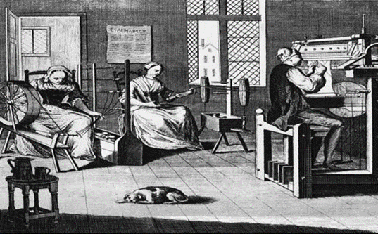

Analytics Is Changing
Cottage Industry
Factory Environment
Characteristics
Strategic importance
Number of models
Number of data scientists
Specialization of work
Automated processes
Limited
Few
Few
Broad
Few
Critical to organizational success
Thousands
Many
Highly
Highly

Slide 22
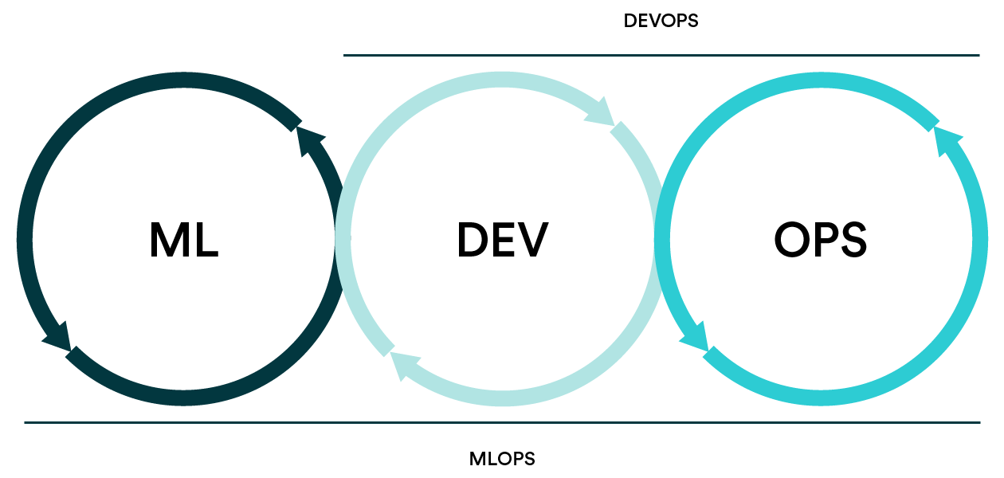
The Emergence of MLOps
MLOps is still in the emerging stage
It builds on modeling and model management, DevOps, and DataOps concepts
It involves people, processes, and technology to build, operate, monitor, and update models
It integrates model development, deployment, monitoring, and updating
It breaks down the silos of development and operations
We will not delve deeply into it in this course, but you may find it important where you work

Slide 23
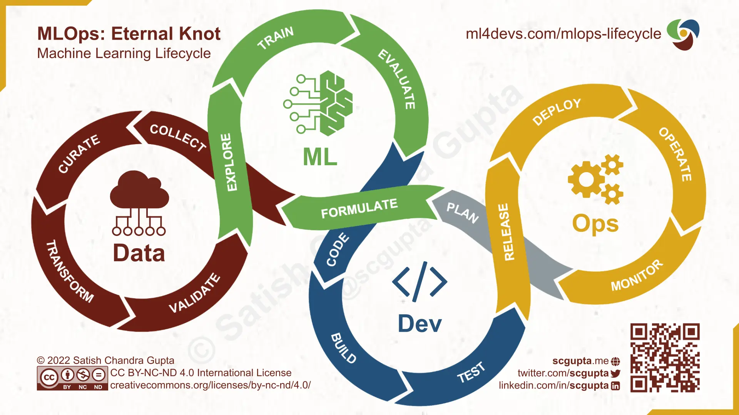
Models and Model Management
MLOps
Operations
DataOps
DevOps
Source: Adapted from Satish Gupta

